Slide 1
Creating a Framework for Static Analysis of Vulnerabilities in Android Applications
CSE7310 Capstone Project
Review-3
Batch Number: IST-03
Under the Supervision of,
Prof. Srinivas Mishra
Assistant Professor
School of Computer Science and Engineering
Presidency University
Roll Number | Student Name
20211IST0015 | Azmath Patel
20211IST0018 | Rajavardhan R
Name of the Program: B.Tech in Information Science And Technology
Name of the HoD: Dr.Pallavi R
Name of the Program Project Coordinator: Prof. Srinivas Mishra
Name of the School Project Coordinators: Dr. Sampath A K

Slide 2
Content
Abstract
Literature Review
Objectives
Existing Methods –Drawbacks
Proposed Method
Methodology
Modules
Software Requirements
Timeline by Gantt Chart
Expected Outcomes
Conclusion
References
GitHub Link

Slide 3
Abstract
Creating a Framework for Static Analysis of Vulnerabilities in Android Applications
With the rapid growth of Android applications, ensuring security is a critical concern. This project aims to develop a framework for static analysis of Android applications using AndroGuard to identify vulnerabilities without executing the application. The framework will analyze APK files or source code, detect security flaws, and generate comprehensive reports in HTML, PDF, or JSON formats.
By automating vulnerability detection, the proposed framework will assist developers in building more secure applications, minimizing security risks, and improving the overall security posture of Android apps.

Slide 4
Literature Review
Sl. No | Title of the Paper | Authors | Technology/Concept Used | Results/Findings | Limitations/Challenges
1 | Static Analysis of Android Apps: A Systematic Literature Review | Li, L., Bartel, A., Bissyande, T. F., Klein, J., Le Traon, Y., & Cavallaro, L. (2017) | Systematic literature review on static analysis techniques for Android applications | Provides an extensive review of existing static analysis techniques for Android apps, highlighting trends and gaps | Limited to published research; lacks real-world validation of some techniques
2 | Revisiting Static Analysis of Android Malware | Bartel, A., Klein, J., Monperrus, M., & Le Traon, Y. (2012) | Methodologies and challenges in static analysis of Android malware | Discusses the effectiveness and shortcomings of static analysis in detecting Android malware | Static analysis alone may be insufficient due to code obfuscation and evasion techniques used by malware developers
3 | FlowDroid: Precise Context, Flow, Field, Object-sensitive and Lifecycle-aware Taint Analysis for Android Apps | Arzt, S., Rasthofer, S., Bodden, E., & Lovat, E. (2014) | Taint analysis for Android applications | Provides highly precise and efficient taint tracking for Android apps | Can be computationally expensive; does not handle dynamic code loading well

Slide 5
Literature Review
Sl. No | Title of the Paper | Authors | Technology/Concept Used | Results/Findings | Limitations/Challenges
4 | Mobile Security Framework (MobSF) | Cyberlands (2024) | Open-source tool for automated analysis of mobile applications | Automates security analysis of mobile applications, identifying vulnerabilities | Limited support for advanced obfuscation techniques; requires manual verification of some findings
5 | Security Code Smells in Android ICC | Pascal Gadient, Mohammad Ghafari, Patrick Frischknecht, Oscar Nierstrasz | Code Smell Detection | Identified risky code patterns in inter-component communication. | Focused narrowly on ICC smells.
6 | Static Analysis of Android Secure Application Development Process Using FindSecurityBugs | FindSecurityBugs (2024) | Security-focused static analysis tool for Java and Android | Helps developers identify security flaws early in the development process | Limited scope in detecting complex vulnerabilities; relies on known security patterns
7 | A Large-Scale Empirical Study on Android Static Analysis Tools | Wei, F., Roy, S., Ou, X., & Robby (2018) | Comparative analysis of various static analysis tools for Android | Evaluates the accuracy, precision, and performance of multiple tools | Some tools struggle with complex app structures and obfuscation

Slide 6
Literature Review
Sl. No | Title of the Paper | Authors | Technology/Concept Used | Results/Findings | Limitations/Challenges
8 | DroidSafe: A Security Analysis Tool for Android Apps | Gordon, M. I., Kim, D., Perkins, J., Gilham, L., Nguyen, H. V., & Rinard, M. (2015) | Information flow analysis for Android security | Detects sensitive data leaks in Android applications | Computationally intensive and may produce false positives
9 | IccTA: Detecting Inter-Component Privacy Leaks in Android Apps | Li, L., Li, D., Bissyande, T. F., Klein, J., Traon, Y. L., Arzt, S., Bodden, E., & Bartel, A. (2015) | Static taint analysis to detect inter-component leaks | Improves detection of data leaks between Android components | Limited by static analysis assumptions; may not catch runtime leaks
10 | DroidLint: A Static Analysis Tool to Detect Privacy Leaks in Android Applications | Chen, K., Johnson, N., Dagon, D., & Zang, H. (2013) | Static analysis using machine learning-based techniques | Effectively detects privacy leaks in Android applications | May require extensive training data for accuracy

Slide 7
Objectives
Develop a user-friendly framework for static analysis of Android applications.
Integrate AndroGuard to automate the detection of security vulnerabilities.
Provide actionable reports to assist developers in mitigating identified issues.
Enhance the security posture of Android applications by facilitating early detection of vulnerabilities.

Slide 8
Existing Methods & Drawbacks
Several tools and techniques exist for analyzing Android applications:
FlowDroid: Performs precise taint analysis but may struggle with scalability and complex app structures.
Amandroid: Offers inter-component data flow analysis but can be resource-intensive.
IccTA: Focuses on inter-component communication but may not cover all vulnerability types.
Drawbacks:
Limited Coverage: Many tools focus on specific vulnerability types, missing others.
Scalability Issues: Analyzing large or complex applications can be time-consuming.
False Positives/Negatives: Static analysis may produce inaccurate results without contextual understanding.

Slide 9
Proposed Method
Input: APK/source code
Analysis Module: Uses AndroGuard for static vulnerability checks
Reporting Module: Exports reports (HTML, PDF, JSON)
Remediation (Optional): Suggests fixes
Output: Clear, actionable vulnerability report

Slide 10
Methodology
Requirement Analysis: Identify the specific needs and scope of the framework.
Design: Architect the framework, ensuring seamless integration with AndroGuard and defining clear workflows for analysis and reporting.
Development: Implement the framework, focusing on modularity and scalability.
Testing: Validate the framework using various Android applications to ensure accuracy and reliability in vulnerability detection.
Deployment: Prepare the framework for use by developers, including comprehensive documentation and user guides.

Slide 11
Modules
1. Input Module
Accepts APK files or source code of Android applications.
Prepares the input for static analysis by extracting necessary components.
2. Analysis Module
Utilizes AndroGuard to perform in-depth static analysis.
Identifies potential security vulnerabilities such as insecure API calls, data leaks, and permission misuse.
3. Reporting Module
Generates detailed vulnerability reports in formats such as HTML, PDF, or JSON.
Categorizes security issues based on severity levels (Low, Medium, High).
4. Remediation Module (Optional)
Provides actionable recommendations for fixing identified vulnerabilities.
Can integrate automated fixes for certain security flaws.
5. Output Module
Displays the final analysis results in a user-friendly format.
Helps developers understand and mitigate risks effectively.

Slide 12
Software Requirements
1. Development Tools & Environment
Python 3.x – Required for integrating AndroGuard and scripting automation
VS Code – Preferred code editor for development
2. Static Analysis Tools
AndroGuard – Core tool for analyzing Android applications
AndroBugs Framework – Additional tool for scanning security risks
3. Dependencies & Libraries
DPandas, JSON, HTML Parser – For processing and structuring vulnerability reports

Slide 13
Timeline of Project
Review Phase | Tasks Covered
0th Review | Project proposal finalization, literature review, requirement gathering
1st Review | System architecture design, module structuring, initial implementation of static analysis module using MobSF
2nd Review | Full implementation of core modules (Analysis, Reporting, Remediation), testing with sample APKs, debugging and refinement
Final Review | Integration, documentation, final testing, and presentation preparation

Slide 14
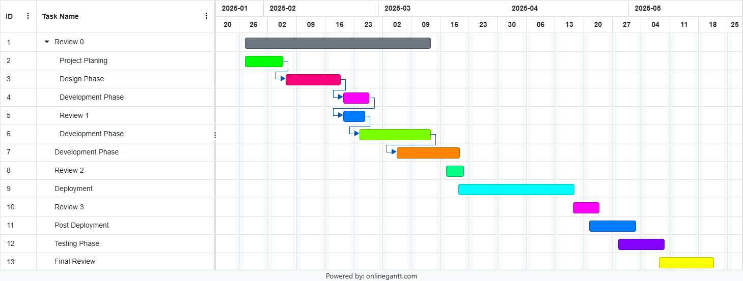
Timeline of the Project (Gantt Chart)

Slide 15
Expected Outcomes
A fully functional framework capable of performing static analysis on Android applications.
Detailed reports highlighting vulnerabilities with recommendations for remediation.
Improved security awareness among developers regarding common vulnerabilities in Android apps.

Slide 16
Conclusion
This project endeavors to bridge the gap in Android application security by providing a robust framework for static analysis. By integrating existing tools like AndroGuard, the framework aims to streamline the vulnerability detection process, enabling developers to produce more secure applications.

Slide 17
References
Li, L., Bartel, A., Bissyande, T. F., Klein, J., Le Traon, Y., & Cavallaro, L. (2017). Static Analysis of Android Apps: A Systematic Literature Review.
Bartel, A., Klein, J., Monperrus, M., & Le Traon, Y. (2012). Revisiting Static Analysis of Android Malware.
Arzt, S., Rasthofer, S., Bodden, E., & Lovat, E. (2014). FlowDroid: Precise Context, Flow, Field, Object-sensitive and Lifecycle-aware Taint Analysis for Android Apps.
FindSecurityBugs. (2024). Static Analysis of Android Secure Application Development Process Using FindSecurityBugs.
Gordon, M. I., Kim, D., Perkins, J., Gilham, L., Nguyen, H. V., & Rinard, M. (2015). DroidSafe: A Security Analysis Tool for Android Apps.
Li, L., Li, D., Bissyande, T. F., Klein, J., Le Traon, Y., Arzt, S., Bodden, E., & Bartel, A. (2015). IccTA: Detecting Inter-Component Privacy Leaks in Android Apps.

Slide 18
References
Wei, F., Roy, S., Ou, X., & Robby. (2018). A Large-Scale Empirical Study on Android Static Analysis Tools.
Chen, K., Johnson, N., Dagon, D., & Zang, H. (2013). DroidLint: A Static Analysis Tool to Detect Privacy Leaks in Android Applications.
Calzavara, S., Grishchenko, I., & Maffei, M. (2016). HornDroid: Practical and Sound Static Analysis of Android Applications by SMT Solving.
Gadient, P., Ghafari, M., Frischknecht, P., & Nierstrasz, O. (2017). Security Code Smells in Android ICC.
Ghafari, M., Gadient, P., & Nierstrasz, O. (2017). Security Smells in Android.
Anwer, S., Aggarwal, A., Purandare, R., & Naik, V. (2015). Android Malware Static Analysis Techniques.

Slide 19
GitHub Link
https://github.com/rajavardhan28/Creating-a-Framework-for-Static-Analysis-of-Vulnerabilities-in-Android-Applications

Slide 20
Thank You

